Slide 1
Silver Oak College
Of
Computer Application

Slide 2
Name :- Shah Aman P.
Sem :- 2.
Divison :- M1A3 & A
Subject Name :- INTERNSHIP OJT
ENROLLMENT NO :- 2204030101272
Project Name :- ASProject|Construction
Project Guide :- Prof.Tanay Shah

Slide 3
Introduction to Aman Shah Construction Website
Project Management Services
Building Inspections
Pricing and Availability
Customer Support
Conclusion

Slide 4
Introduction to Aman Shah Construction Website
Aman Shah Construction is a website that provides construction services to residential and commercial clients. It offers a wide range of services, including construction project management, building inspections, and more. The website is designed to be user-friendly and provides customers with an easy way to find and book services.
Aman Shah Construction also provides detailed information about their services, including pricing, timelines, and more. Customers can also contact the company directly with any questions or concerns they may have.

Slide 5
Project Management Services
Aman Shah Construction offers project management services for residential and commercial projects. They provide customers with a detailed plan for each project, including timelines, budgets, and more. The company also helps customers manage their projects, ensuring that the project is completed on time and within budget.
Aman Shah Construction also provides customers with access to their project management software, which allows customers to track their projects and make changes as needed. This software also helps customers stay organized and on top of their projects.

Slide 6
Building Inspections
Aman Shah Construction also provides building inspections for residential and commercial properties. Their team of experienced inspectors is knowledgeable and can provide detailed reports on the condition of a property. They can also help customers identify any potential issues that may need to be addressed.
Aman Shah Construction also offers consulting services for customers who need help understanding the inspection report or making decisions about their property. They can provide customers with valuable insight and guidance.

Slide 7
Pricing and Availability
Aman Shah Construction offers competitive pricing for their services. Customers can find detailed pricing information on the website, including discounts for multiple services. The company also offers flexible payment options and can work with customers to create a payment plan that meets their needs.
Aman Shah Construction also offers 24/7 availability for their services. Customers can contact the company at any time to discuss their needs and schedule services. The company is also available to answer any questions or concerns customers may have.

Slide 8
Customer Support
Aman Shah Construction provides customers with a dedicated customer support team. The team is available to answer any questions or concerns customers may have about their services. They can also provide customers with helpful advice and guidance.
The customer support team is also available to help customers with any technical issues they may have with the website. They can provide customers with detailed instructions and helpful tips to ensure they are able to use the website without any problems.

Slide 9
Conclusion
Aman Shah Construction is a website that provides customers with a wide range of construction services. The website is designed to be user-friendly and provides customers with an easy way to find and book services. The company also offers competitive pricing and 24/7 availability for their services.
Aman Shah Construction also provides customers with a dedicated customer support team to help with any questions or concerns they may have. The company is committed to providing customers with the best possible service and is dedicated to helping them with their construction projects.

Slide 10
GRAY LAYOUT

Slide 11


Slide 12


Slide 13
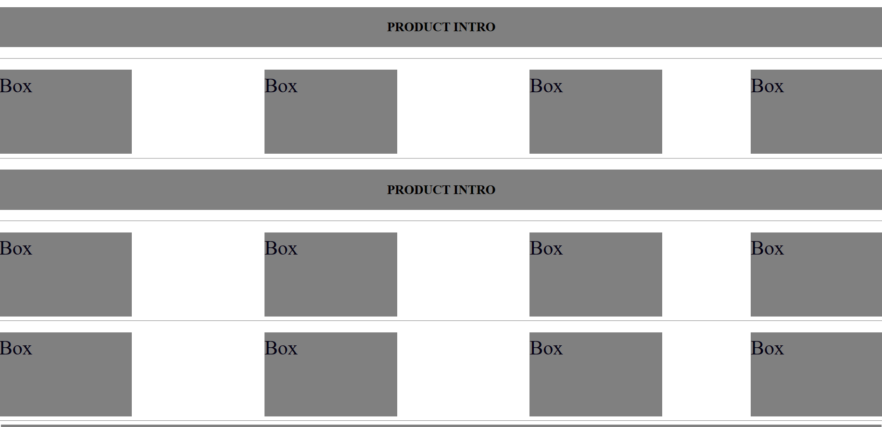

Slide 14


Slide 15
Comparing Aman Shah Construction Company and Adani Infrastructure Limited

Slide 16
Aman Shah Construction Company
Aman Shah Construction Company is a leading construction company in India. It has been in the business of building and developing residential, commercial and industrial projects for over 30 years. The company has a team of experienced professionals who work with the highest standards of quality and safety. It has a strong presence in the construction industry and is known for its innovative and sustainable solutions.
Aman Shah Construction Company is known for its commitment to customer satisfaction and its ability to deliver projects on time and within budget. The company has a strong focus on environmental sustainability and is committed to reducing its carbon footprint. It is also committed to creating jobs and providing economic opportunities for its employees.

Slide 17
Adani Infrastructure Limited
Adani Infrastructure Limited is a leading infrastructure company in India. It has been in the business of developing and operating airports, ports, roads, railways, power plants, and other infrastructure projects for over 25 years. The company has a team of experienced professionals who work with the highest standards of quality and safety. It has a strong presence in the infrastructure industry and is known for its innovative and sustainable solutions.
Adani Infrastructure Limited is known for its commitment to customer satisfaction and its ability to deliver projects on time and within budget. The company has a strong focus on environmental sustainability and is committed to reducing its carbon footprint. It is also committed to creating jobs and providing economic opportunities for its employees.

Slide 18

Comparing Aman Shah and Adani Infrastructure
Aman Shah Construction Company and Adani Infrastructure Limited are both leading infrastructure companies in India. They both have a team of experienced professionals and a commitment to customer satisfaction. However, there are some key differences between the two companies. Aman Shah Construction Company is more focused on residential and commercial projects, while Adani Infrastructure Limited is more focused on airports, ports, roads, railways, power plants, and other infrastructure projects.
Both companies have a strong focus on environmental sustainability and are committed to reducing their carbon footprint. They also both have a commitment to creating jobs and providing economic opportunities for their employees. However, Adani Infrastructure Limited has a slightly larger presence in the infrastructure industry and is known for its innovative and sustainable solutions.

Slide 19
Advantages of Aman Shah Construction Company
Aman Shah Construction Company has several advantages over Adani Infrastructure Limited. The company has a strong presence in the construction industry and is known for its innovative and sustainable solutions. It is also known for its commitment to customer satisfaction and its ability to deliver projects on time and within budget. Furthermore, the company has a team of experienced professionals who work with the highest standards of quality and safety.
In addition, Aman Shah Construction Company is more focused on residential and commercial projects, which allows the company to specialize in certain areas and provide more tailored solutions to its customers. The company also has a strong focus on environmental sustainability and is committed to reducing its carbon footprint.

Slide 20
Conclusion
Aman Shah Construction Company and Adani Infrastructure Limited are both leading infrastructure companies in India. They both have a team of experienced professionals and a commitment to customer satisfaction. However, there are some key differences between the two companies. Aman Shah Construction Company is more focused on residential and commercial projects, while Adani Infrastructure Limited is more focused on airports, ports, roads, railways, power plants, and other infrastructure projects.
Both companies have a strong focus on environmental sustainability and are committed to reducing their carbon footprint. They also both have a commitment to creating jobs and providing economic opportunities for their employees. Ultimately, the decision of which company to use will depend on the specific needs and goals of the customer.

Slide 21
THANK YOU

